Slide 1

TECHNOLOGY & THEORY
MVC
THE SIMPLEST COMPLICATION
Presented by Kevin Cox

Slide 2

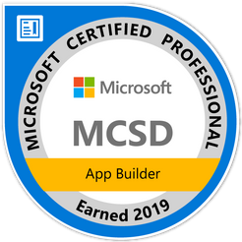



Kevin Cox
Sr. Software Engineer
Sovos ETM
Owner/CEO
TEC Vector
https://www.linkedin.com/in/kevinacox1985/
@KEVINACOX85
TECVECTOR@OUTLOOK.COM
/TECVECTOR
Meetup: Cedar-Rapids-NET-Meetup-Group

Slide 3

Covered Today
A brief outline
What is MVC5?
When to use MVC5
Practical Mistakes Made
Future of MVC with Core and Blazor
Hands on demo
Questions/Comments

Slide 4
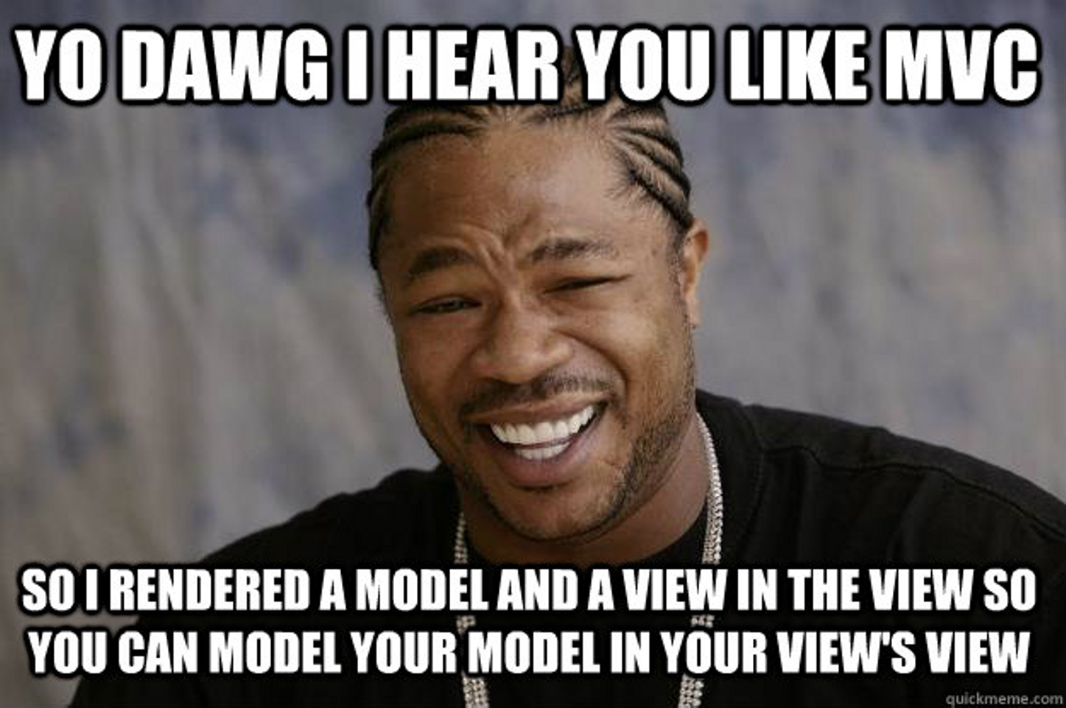

Slide 5



WHAT IS MVC
MODEL
VIEW
CONTROLLER
The data objects, classes, and basic presentation materials
Server processed, browser rendered
Data layer control, mappings, and basic logic

Slide 6


Design Pattern?
Framework?

Slide 7



Time and a Place
MVC is not the end-all of Web Code
Integrations
Many Moving Pieces
Heavy Data

Slide 8

Relationship with Technology
MVC SHOULD BE DUMB
PROPER DISCIPLINE SAVES YOU A HEADACHE

Slide 9
Where do we go next?
HOW DO WE GET THERE?
HTTPS://DOCS.MICROSOFT.COM/EN-US/ASPNET/CORE/MVC/OVERVIEW?VIEW=ASPNETCORE-3.0

Slide 10
